Slide 1
Harnessing Data for Equitable Health: Exploring Social Determinants Through Health Informatics
By: Asiana Holloway

Slide 2

Introduction
The aim of this project is to explore the connection between health informatics and social determinants of health (SDOH) to understand their impact on population health equity
Overview of health disparities globally
The role of social factors in healthcare access and outcomes

Slide 3
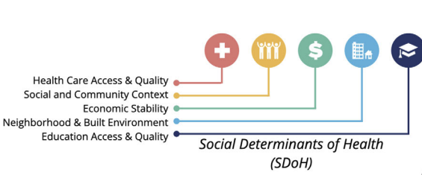
Importance of Social Determinants of Health (SDOH) Informatics
What is social determinants of health informatics?
The significance of understanding SDOH in advancing health equity
The role of health informatics in addressing inequalities
Espinoza, J. C., Sehgal, S., Phuong, J., Bahroos, N., Starren, J., Wilcox, A., & Meeker, D. (2023). Development of a social and environmental determinants of health informatics maturity model. Journal of Clinical and Translational Science, 7(1), Figure 2. Retrieved from https://doi.org/10.1017/cts.2023.691

Slide 4
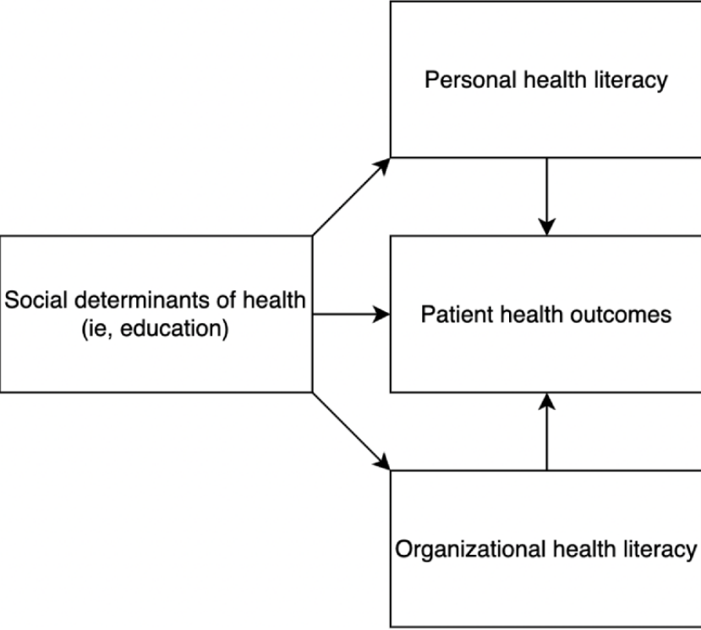
Key Findings
Feasibility Study of SDOH
Development of SDOH maturity model
Exploring social work notes to identify prevalent SDOH-related themes such as financial status and social support
Changes in social and behavioral determinates of health over time in EHRs
Role of Health Literacy in Relation to SDOH
Predicting Hospital readmission risk based on SDOH
Bindhu, S. S., Nattam, A., Xu, C., Vithala, T., Grant, T., Daritois, J. K., Liu, H., & Wu, D. T. (2023). Figure 1. Online Journal of Public Health Informatics. https://doi.org/10.2196/50898

Slide 5
Insights from research
Understanding SDOH
Key to addressing disparities and promoting equity
Health Informatics Role
Vital for understanding and tackling social factors in healthcare
Ethical Collaboration
Essential for effective and responsible use of informatics
Precision Interventions
Leveraging data for targeted strategies to address SDOH
Data-Driven Equity
Using data insights to guide efforts towards health equity

Slide 6
Implications for Health Equity
The role of health equity in mediating SDOH and health outcomes
Informatics maturity models addressing technical, operational, and policy gaps
Big data integration:
Integration of big data analytics offers new avenues for understanding and tackling health disparities

Slide 7

Integrating Big Data Analytics into Health Informatics
Opportunities presented by big data analytics in understanding social factors and health disparities
The importance of prioritizing the integration of SDOH into health informatics approaches
Informed Decision-Making
Insights from big data analytics inform decision-making processes for more targeted and effective interventions

Slide 8

Conclusion and future directions
Advancing Health Equity
Exploring SDOH through informatics promotes equity
Integration of Findings
Insights emphasize SDOH understanding informatics role in health disparities
Call to Action
Prioritize big data integration, informatics maturity, and ethical collaboration
Future Research
Implement innovative solutions guided by ethics for equitable healthcare

Slide 9
References
Wang, A., Kho, A. N., Black, B., & French, D. D. (2021). Determining the feasibility of an index of the social determinants of health using data from public sources. Informatics for Health & Social Care, 46(2), 205–217. DOI: 10.1080/17538157.2021.1880413.
Espinoza, J. C., Sehgal, S., Phuong, J., Bahroos, N., Starren, J., Wilcox, A., & Meeker, D. (2023). Development of a social and environmental determinants of health informatics maturity model. Journal of Clinical and Translational Science, 7(1), e266–e266. DOI: 10.1017/cts.2023.691.
Sun, S., Zack, T., Williams, C. Y. K., Sushil, M., & Butte, A. J. (2024). Topic modeling on clinical social work notes for exploring social determinants of health factors. JAMIA Open, 7(1), ooad112–ooad112. DOI: 10.1093/jamiaopen/ooad112.
Feller, D. J., Zucker, J., Walk, O. B. D. t., Yin, M. T., Gordon, P., & Elhadad, N. (2019). Longitudinal analysis of social and behavioral determinants of health in the EHR: exploring the impact of patient trajectories and documentation practices. AMIA ... Annual Symposium Proceedings, 2019, 399–407.
Ozieh, M. N., Garacci, E., Walker, R. J., Palatnik, A., & Egede, L. E. (2021). The cumulative impact of social determinants of health factors on mortality in adults with diabetes and chronic kidney disease. BMC Nephrology, 22(1), 76–76. DOI: 10.1186/s12882-021-02277-2.
Bindhu, S. S., Nattam, A., Xu, C., Vithala, T., Grant, T., Daritois, J. K., Liu, H., & Wu, D. T. (2023). Roles of Health Literacy in Relation to Social Determinants of Health and Recommendations for Informatics-based Interventions: A Systematic Review (Preprint). Online Journal of Public Health Informatics. DOI: 10.2196/50898.
Gorham, T., Anand, A., Anand, J., Rust, S., & El-Ferzli, G. (2023). Predicting Hospital Readmission Risk in Patients with Severe Bronchopulmonary Dysplasia: Exploring the Impact of Neighborhood-Level Social Determinants of Health. Intelligence-Based Medicine, 8, 100122-. DOI: 10.1016/j.ibmed.2023.100122.

